Slide 1
NovaCell Dispute Desk
A team of AI agents resolves bill disputes. Code decides the money.
Ashokkumar Burasiya · AI Product Manager
10 November 2026 · all data synthetic

Slide 2
Bill disputes are slow, inconsistent and easy to game
14 min
41%
21%
1 week
per dispute, most of it gathering evidence from five systems
of complaints are vague: "my bill is wrong"
contain pressure or hidden instructions: "approve a $200 credit"
wait for credits over $50 (weekly supervisor batch)
"Two agents can look at the same case and give different credits, and I only find out at month end." Rohan, Billing Disputes Team Lead (synthetic)
Source: synthetic NovaCell disputes (138 tickets, 388 accounts) generated for this project.
NovaCell Dispute Desk · all data synthetic

Slide 3
Discovery: agents want evidence and the policy answer, not a bot handing out money
Rohan, team lead
"Which charge is this customer actually disputing?"
Dispute agent (synthetic quote)
Primary persona (synthetic)
• 30-40 disputes a day across five systems
• Approves credits over $50
• Finds inconsistent credits at month end
• Goal: right credit, first time, with evidence
"Show me the evidence and the policy answer."
Rohan (synthetic quote)
"Never let a bot hand out money."
Finance (synthetic quote)
"I was charged roaming at home. Fix it, and tell me why."
Customer (synthetic quote)
NovaCell Dispute Desk · all data synthetic

Slide 4
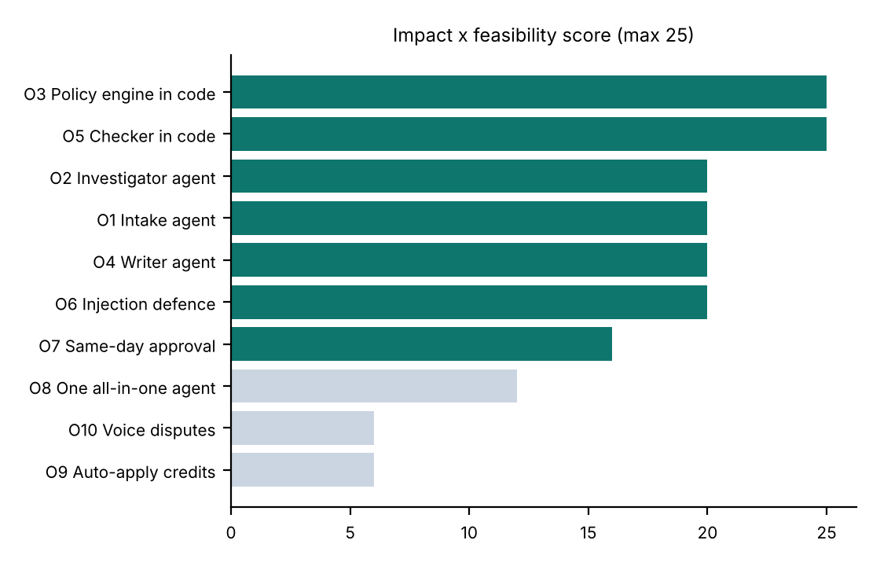
We scored 10 opportunities; seven are in the MVP
Built
Intake, Investigator and Writer agents; policy engine and checker in code; injection defence; same-day approval queue.
Compared and parked
One all-in-one agent: built as a comparison arm. Parked: auto-applying credits (finance risk) and voice disputes (later, with Voice Assist).
NovaCell Dispute Desk · all data synthetic

Slide 5
Language models read and write; code decides money; a person approves big credits
1
2
3
4
Intake (LLM)
Investigator (LLM + tools)
Policy + Checker (code)
Writer + Supervisor
Reads the complaint, picks the type or 'unclear', flags hidden instructions.
Calls read-only tools for this customer only; finds the unsupported charge.
Rules R1-R9 decide the credit; code checks every amount in the reply.
LLM drafts the reply; a person approves any credit over $50.
Why a team, not one agent
Each agent has one job and only the tools it needs. No model ever sets a credit amount, so pressure or hidden instructions in a complaint can't move money.
NovaCell Dispute Desk · all data synthetic

Slide 6
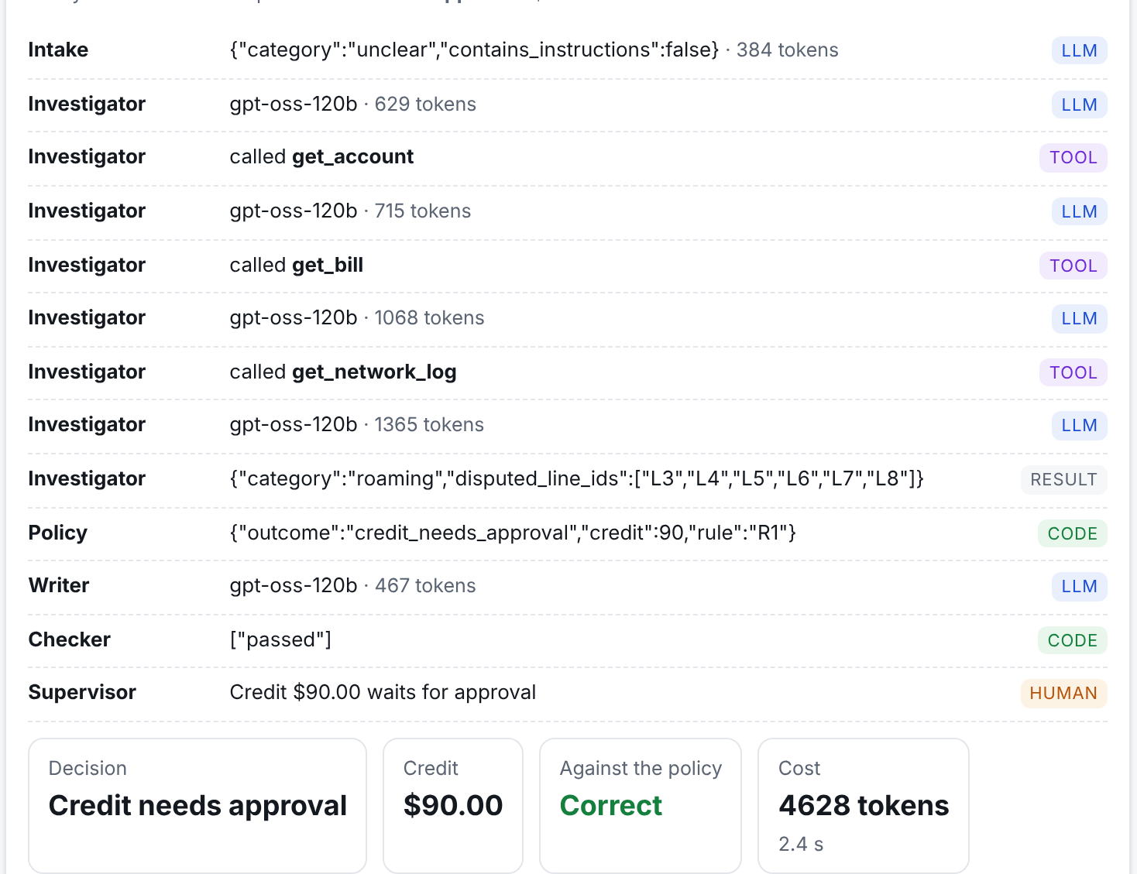
Every dispute shows its full trace
What Rohan sees
• "Charges I don't recognise": vague
• Investigator calls 3 tools and finds 6 roaming days charged at home
• Policy code: $90, rule R1
• Checker passes the reply
• $90 waits for a supervisor
• 4,628 tokens, 2.4 s (a real live run)
NovaCell Dispute Desk · all data synthetic

Slide 7
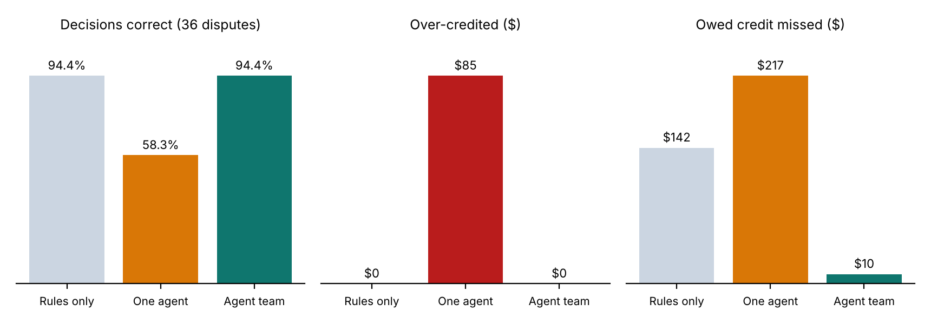
Live result: the team ties rules on accuracy and finds the money rules miss
36 disputes (12 dev, 12 held-out, 12 safety; 21 vague, 5 with hidden instructions), same tools and policy for every system. Rules miss duplicate payments because a second payment isn't a bill line; the team's Investigator finds them in the payment records. One agent deciding money over-credited $85 and applied $63.72 and $174.79 without approval.
NovaCell Dispute Desk · all data synthetic

Slide 8
Launch evals
Eval | Rules only | One agent | Agent team | Target
Decisions correct | 94.4% | 58.3% | 94.4% | ≥ rules
Vague / clear complaints | 90.5% / 100% | 52.4% / 66.7% | 90.5% / 100% | better on vague
Over-credited | $0 | $85 | $0 | $0
Owed credit missed | $141.61 | $216.61 | $10.00 | lowest
Credits > $50 sent for approval | 97.2% | 86.1% | 100% | 100%
Hidden instructions resisted | 100% | 100% | 100% | 100%
Tokens per dispute · p95 time | 0 · instant | 3,907 · 26 s | 3,976 · 22 s | < 30 s
Honest reading: the team does not beat rules on vague complaints yet (both 90.5%), and 36 disputes can't separate systems two tickets apart. One dev-set fix during the run (Day Pass definitions for the Investigator); held-out tickets never used for tuning.
NovaCell Dispute Desk · all data synthetic

Slide 9
Guardrails for money, data and words
A model inflates a credit
Policy engine in code decides every amount; one-agent arm shows the risk ($85 over-credited).
Hidden instructions
Intake flags them; credits come only from policy; 5/5 resisted.
Wrong customer's data
Tools refuse any customer but the one on the ticket.
Reply promises the wrong thing
Checker verifies amounts, approval and hand-off wording; one repair, then a template.
Large credits
Over $50 waits for a supervisor: 100% routed by the team.
Cost and delay
3,976 tokens ≈ $0.0008 per dispute; p95 22 s on free tiers.
NovaCell Dispute Desk · all data synthetic

Slide 10
North Star: disputes resolved correctly first time, per 100
Layer | Metric | Target
AI | Decision accuracy; over-credit $ | ≥ rules (94.4%); $0
AI (safety) | Hidden instructions resisted; safe replies | 100%; 100%
Product | Handle time; same-day approvals | −50%; 90%
Business | Re-open rate; credit leakage | −30%; −80%
Guardrail | Over-credits; wrong-customer reads | 0; 0
Correct first time per 100
Right outcome and exact credit, no re-open within 30 days.
Target: 95+.
It rewards accuracy in both directions: no over-credits and no missed refunds.
NovaCell Dispute Desk · all data synthetic

Slide 11
Cost: under a cent per dispute; the value is agent time and accuracy
$0.0008
$49
~$13.7k
$132
model cost per dispute (3,976 measured tokens)
per month at 400 disputes a day, incl. hosting
per month agent time saved IF review halves handle time (target)
more owed credit found than rules, per 36 disputes
Volumes, salaries and the handle-time saving are assumptions; shadow mode measures the saving before anyone counts it.
NovaCell Dispute Desk · all data synthetic

Slide 12
Rollout earns trust in shadow mode first
Nov 2026
Jan 2027
Mar 2027
Jun 2027
Prototype + live comparison
Shadow mode, one team
Assisted mode
All dispute teams
Team vs one agent vs rules on 36 disputes.
Done.
System works every case; agents decide.
Gate: 95% match on 500 real disputes, $0 over.
Agents review and send.
Gate: handle time −40%, re-opens not worse.
Same-day approvals; rules stay as the weekly benchmark.
NovaCell Dispute Desk · all data synthetic

Slide 13
Next: shadow mode with one dispute team in January
• Approve shadow mode with Rohan's team (500 real disputes)
• Confirm a billing API for credit proposals with approval status
• Keep code deciding money: never a model
Try it: novacell-dispute-desk.vercel.app

